Slide 1

Motivating the Convolutional Neural Network
Matthew Engelhard
Many slides created by Tim Dunn
Notes:
Hi Everyone. In this lecture, we’ll be returning to some ideas
we covered in our previous lectures on logistic regression and the multilayer perceptron
We’ll see that when working with images, these models have an important shortcoming
namely, that their identification of patterns in images – in MNIST, these patterns were ones and zeros –
their identification of those patterns depends on the patterns being located in a specific region of the image.
In MNIST, this isn’t a problem, as the handwritten digits are always centered on the page.
However, as we move toward more complicated image analysis tasks,
it will be important that we have a model that is not limited in this way
That model, as we’ll see, will be the convolutional neural network.

Slide 2

Mask R-CNN
Notes:
As we discussed in our introductory lecture, convolutional neural networks are used in a wide variety of image processing and image analysis tasks
They’re used by self-driving cars to understand road scenes: here we see a model that detects and outlines individual cars, people, and other objects that are on or near the road

Slide 3
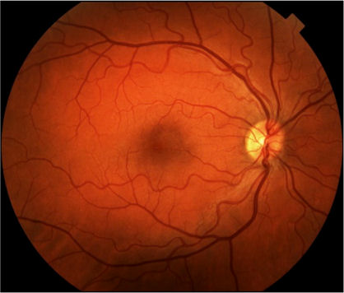
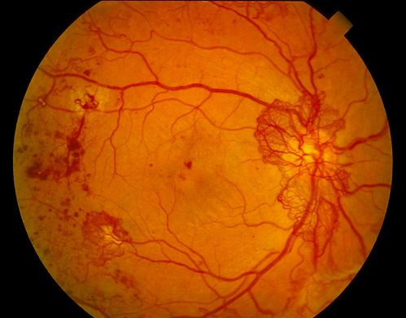

Deep Learning for Image Analysis
Diabetic Retinopathy Classification
Healthy Retina
Unhealthy Retina
Notes:
These models are also being used in medicine to identify referable diabetic retinopathy, identify malignant skin lesions, and even detect colon polyps
Here we see a healthy retina on the left and an unhealthy retina on the right
How do we know it’s unhealthy? Well, one thing we might notice is that there are a number of hemorrhages, particularly on the left side of the image
Whenever hemorrhages like these are present – and wherever they’re present in the image – it’s a clue that there’s pathology
So we need a model that will recognize these hemorrhages wherever they might be located

Slide 4
Motivating the CNN: Back to MNIST
Ones
Zeros
Notes:
To see why our previous models fall short here – why their recognition of image features is tied to a particular location – let’s go back to our previous example
As before, we’ll be talking about models that predict whether a handwritten digit is a zero or a 1
And we’ll think about how things will go wrong if we can no longer count on those handwritten digits appearing in the center of the image

Slide 5
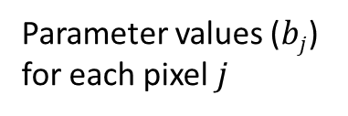
A “Filter” to Detect Ones
Parameter values ($bj$)
for each pixel $j$
Notes:
Remember, we can view the parameters of our logistic regression model as a filter that identifies images that look like it.

Slide 6
A “Filter” to Detect Ones
Positive Section
Notes:
When we compare this filter to an image of a 1, we see that the positive pixels in the filter line up with the positive pixels in the image – the bright pixels

Slide 7

A “Filter” to Detect Ones
Positive Section
$$σ\left( \right)=.991$$
Notes:
As a result, the dot product of the image and the filter will be large and positive, and therefore the output of the model, which represents the probability that the image represents a 1, will be close to 1.

Slide 8
What if we’d like to find a 1 anywhere in a larger image?
Notes:
But now, let’s consider a more difficult version of the problem.
Before, all of the digits were centered in the image
Now, let’s think about using the same approach to identify whether a 1 is present anywhere in the image above
It might be in the center, but it might also be in the upper left

Slide 9
Searching for a 1…
Notes:
Or the upper right

Slide 10
Searching for a 1…
Notes:
Or the lower left

Slide 11
Searching for a 1…
Notes:
Or the lower right
We want a model that will predict that the image contains a 1 – in other words, the predicted probability of 1 should be high – in each of these cases

Slide 12
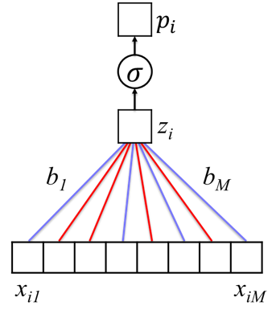
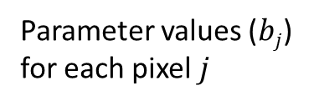
A “Filter” to Detect Ones
VECTORIZE
Parameter values ($bj$)
for each pixel $j$
Notes:
Remember that from before, there’s an exact correspondence between the pixels in the image and the pixels in the filter.
We multiply the image pixel by the corresponding filter pixel – in other words, the corresponding model parameter – and then we add up the values across all the pixels
This gives us the log odds z_i

Slide 13
Our previous approach looks for a 1 at a specific location.
MLP Classifier
Notes:
So, because of that exact correspondence between pixels in the image and pixels in the filter, our filter is looking for a 1 in a specific location.

Slide 14
Our previous approach looks for a 1 at a specific location.
“1”
MLP Classifier
Notes:
If a 1 is present in exactly the location where the filter expects it to be, then the bright pixels in the image will match the positive pixels in the filter, and the model will predict that a 1 is present

Slide 15
If we move the position of the 1, it no longer works.
?
MLP Classifier
Notes:
But if we MOVE the 1, then the bright pixels in the image are no longer aligned with the positive pixels in the filter
As a result, our classifier has no idea whether this is a 1 or a 0

Slide 16
Instead of using logistic regression or an MLP, let’s look for a new kind of model, one with more flexible filters
“1”
New Classifier
Notes:
In logistic regression, our filter was the size of the image – one pixel, one parameter
In the MLP, we got more filters – which gave us more flexibility – but each one was still the size of the whole image
What we’d really like is a model with smaller filters – filters that can move around the image to find specific patterns no matter where they might be located
Even if the training set only contains ones in the upper left corner, such a model would be able to identify ones in the lower left corner, or anywhere else.

Slide 17
Instead of a filter that’s the size of the whole image, we’d like a smaller filter that we can move around
Notes:
Let’s think of the filter we’ve seen many times now as a small filter – about a quarter of the size of the image – that we can move around the image
When we place it in the top left of this image, the dot product of the filter and the underlying portion of the image is roughly zero

Slide 18
As we move this filter, we calculate the inner product between the filter itself and the portion of the image that’s underneath it.
Notes:
We move the filter to the upper right of the image, but again, we get a dot product of about zero
The filter doesn’t look much like the image in that location – if it did the dot product would be large and positive
It doesn’t look like the opposite of the filter, either – if it did, the dot product would be large and negative
But again, here the dot product will be roughly zero

Slide 19
When the filter is placed over a region that looks like the filter, the inner product (i.e. filter output) will be large.
Notes:
But when the filter is placed over the image of the one, we will, finally, get a dot product that is large and positive
This is a signal saying that ‘there’s a 1 here’!

Slide 20
When it’s placed over a region that does not look like the filter, the inner product (i.e. filter output) will be small
Notes:
And finally, in the bottom right corner we’ll again get a dot product of about zero

Slide 21
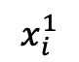

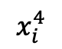
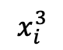
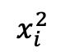
Examining filter output $σ(x_{i}^{R}⊙b)$, where $x_{i}^{R}$ is the portion of image $i$ where the filter is placed.
$$x_{i}^{1}$$
$$x_{i}^{2}$$
$$x_{i}^{3}$$
$$x_{i}^{4}$$
Notes:
Let’s go over that again, but this time we’ll capture all of our results in a grid

Slide 22
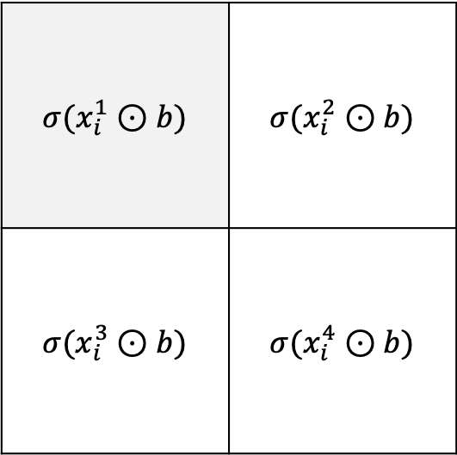
Examining filter output $σ(x_{i}^{R}⊙b)$, where $x_{i}^{R}$ is the portion of image $i$ where the filter is placed.
$$σ(x_{i}^{1}⊙b)$$ | $$σ(x_{i}^{2}⊙b)$$
$$σ(x_{i}^{3}⊙b)$$ | $$σ(x_{i}^{4}⊙b)$$
$$x_{i}^{1}$$
$$x_{i}^{2}$$
$$x_{i}^{3}$$
$$x_{i}^{4}$$
Notes:
We place the filter in the top left of the image, and the resulting dot product is about 0
So, we put a zero as the top left entry of the 2x2 grid on the right
Each element of the grid corresponds to a location where the filter will be placed

Slide 23
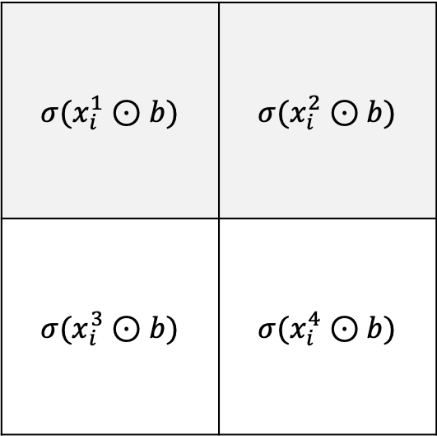
Examining filter output $σ(x_{i}^{R}⊙b)$, where $x_{i}^{R}$ is the portion of image $i$ where the filter is placed.
$$σ(x_{i}^{1}⊙b)$$ | $$σ(x_{i}^{2}⊙b)$$
$$σ(x_{i}^{3}⊙b)$$ | $$σ(x_{i}^{4}⊙b)$$
$$x_{i}^{1}$$
$$x_{i}^{2}$$
$$x_{i}^{3}$$
$$x_{i}^{4}$$
Notes:
We place the filter in the top right of the image, and again the output is about zero – we’ll write it down in the upper right element of our grid

Slide 24
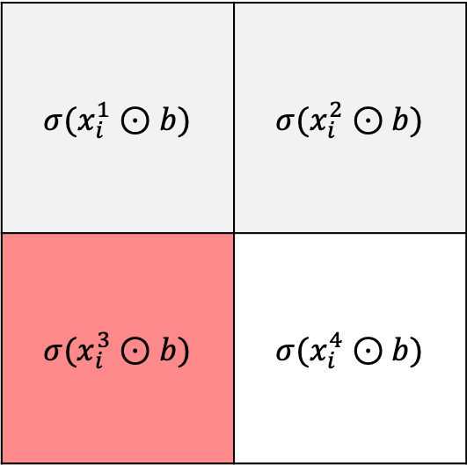
Examining filter output $σ(x_{i}^{R}⊙b)$, where $x_{i}^{R}$ is the portion of image $i$ where the filter is placed.
$$σ(x_{i}^{1}⊙b)$$ | $$σ(x_{i}^{2}⊙b)$$
$$σ(x_{i}^{3}⊙b)$$ | $$σ(x_{i}^{4}⊙b)$$
$$x_{i}^{1}$$
$$x_{i}^{2}$$
$$x_{i}^{3}$$
$$x_{i}^{4}$$
Notes:
We get to the bottom right portion of the image, and positive elements of filter and image are aligned – the resulting dot product is large, so we write it down.

Slide 25
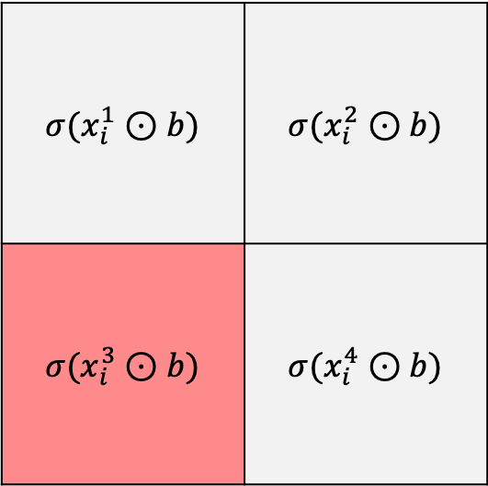
Examining filter output $σ(x_{i}^{R}⊙b)$, where $x_{i}^{R}$ is the portion of image $i$ where the filter is placed.
$$σ(x_{i}^{1}⊙b)$$ | $$σ(x_{i}^{2}⊙b)$$
$$σ(x_{i}^{3}⊙b)$$ | $$σ(x_{i}^{4}⊙b)$$
$$x_{i}^{1}$$
$$x_{i}^{2}$$
$$x_{i}^{3}$$
$$x_{i}^{4}$$
Notes:
And the last element of our grid, the bottom right element, is 0

Slide 26
What if we want to know if a 1 is present anywhere in the image?
$$σ(x_{i}^{1}⊙b)$$ | $$σ(x_{i}^{2}⊙b)$$
$$σ(x_{i}^{3}⊙b)$$ | $$σ(x_{i}^{4}⊙b)$$
$$x_{i}^{1}$$
$$x_{i}^{2}$$
$$x_{i}^{3}$$
$$x_{i}^{4}$$
Notes:
So, we moved this filter around the image, took a dot product in each location, and wrote down the results in a grid.
Based on this grid, how can we determine whether a 1 is present ANYWHERE in the image?
It might be worth pausing at this point to give it some thought

Slide 27
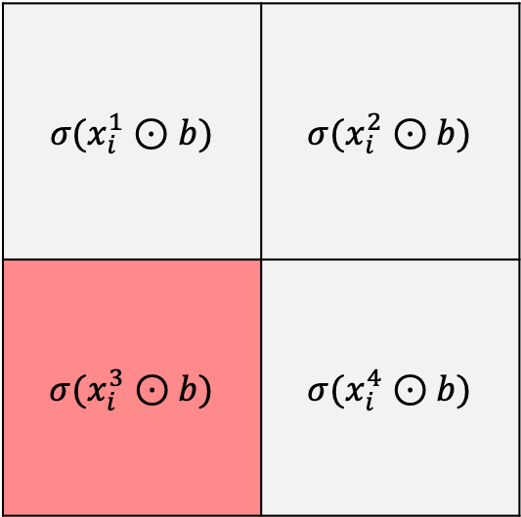
What if we want to know if a 1 is present anywhere in the image?
$$σ(x_{i}^{1}⊙b)$$ | $$σ(x_{i}^{2}⊙b)$$
$$σ(x_{i}^{3}⊙b)$$ | $$σ(x_{i}^{4}⊙b)$$
MAX
Notes:
Our grid tells us where in the image a 1 is present
If we want to know whether a 1 is present anywhere in the image, we can take the maximum of all elements in the grid
If the maximum is close to zero, then the filter didn’t match the image in any of the locations
If the maximum is close to 1, then the filter matched the image in at least one location, suggesting a 1 is present in at least one location

Slide 28
This idea is called “max pooling”, and is widely used in CNNs to determine whether features are present in a given region
$$σ(x_{i}^{1}⊙b)$$ | $$σ(x_{i}^{2}⊙b)$$
$$σ(x_{i}^{3}⊙b)$$ | $$σ(x_{i}^{4}⊙b)$$
MAX
Notes:
This idea is called “max pooling”, and it’s commonly used in CNNs
We often care only whether an object is present anywhere in an image – we’re less worried about where specifically it’s located

Slide 29
Deep Learning for Image Analysis
Diabetic Retinopathy Classification
Healthy Retina
Unhealthy Retina
Notes:
Going back to our retinopathy example, we’re less worried about WHERE hemorrhages are located, and more worried about WHETHER they’re present

Slide 30
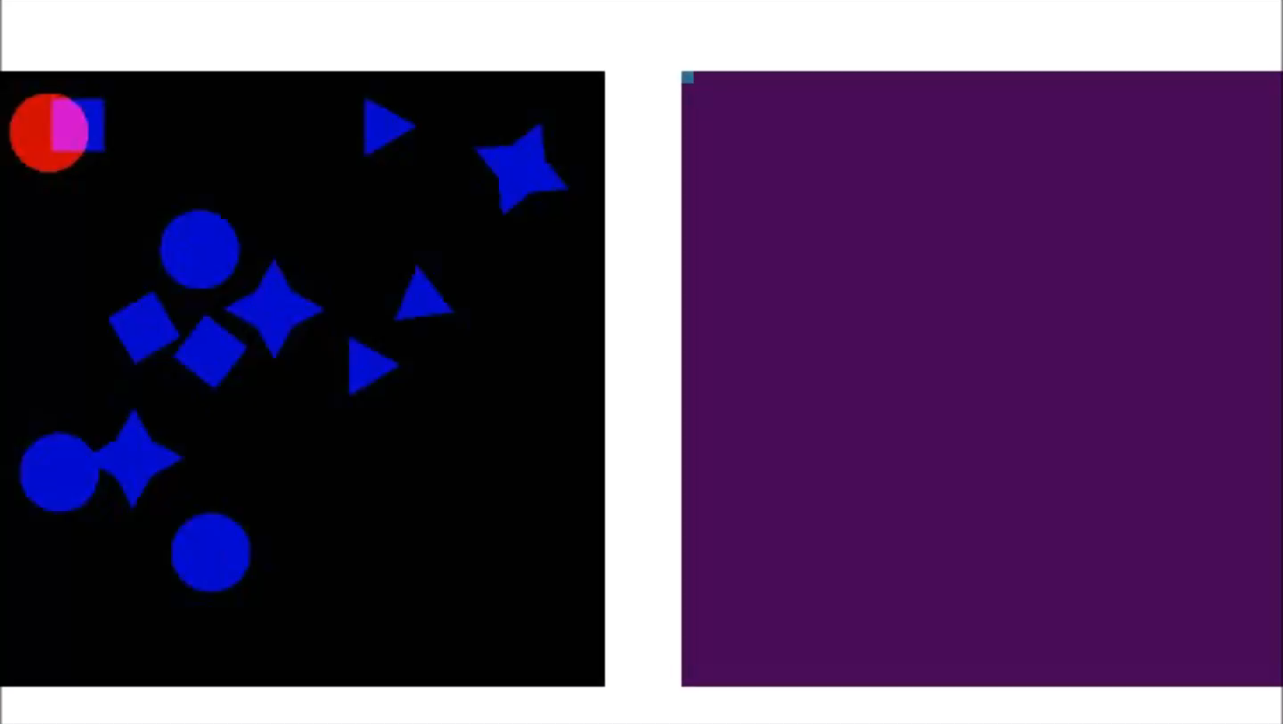
Convolutional Filters Are Feature Detectors
Notes:
Let’s now consider a filter that’s looking for something other than zeros and ones
Here we have a filter that will identify circles
The bright pixels in the filter are shown in red – the filter itself is a circle, and so it detects circles in the underlying image
Just so we can distinguish the image from the filter, the bright pixels in the image are shown in blue
We can move this filter across the image, take a dot product between the filter and the part of the image that’s underneath it, and record the result in the grid on the right
We’ll call this grid a “feature map”, because it tells us where a specific feature is located – in this case, it tells us where the circles are located
Once we’ve moved our circle filter across the whole image, we get a map of the locations of all the circles in the image

Slide 31
Now we know how to identify a “1” or a “0” anywhere in an image.
What if we want to identify a “10”?
Option 1: Design a new filter for “10”
Option 2: Utilize our “1” and “0” filters…
Notes:
So, now we know how we can identify ones and zeros – or circles, or any other feature – in an image
But what if we want to identify a more complex feature – say, a 1 right next to a 0 – in other words, a ten?
One option would be to design a more complex feature for a 10. We can have a filter that looks like a 10, and any time it lines up with a 10, the dot product will be large
But there’s a more elegant option here
Let’s see if we can make use of something we already know how to do -- we already know how to identify ones and zeros

Slide 32
“1” filter output
“0” filter output
Notes:
Consider the image on the left, which contains a 10
If we apply a filter for 1s, we get a map of all the ones
If we apply a filter for 0s, we get a map of all the zeros
The pattern we’re looking for is a 1 next to a 0.
We’re looking for a case where a bright spot in the 1s map is just to the left of a bright spot in the 0s map

Slide 33
“1” filter output
“0” filter output
Our “10” filter looks for a match from the “1”
filter to the left of a match from the “0” filter
Notes:
We can stack these feature maps on top of one another
Now we can think about filters that, instead of being applied to the original image, are applied to the feature maps
It’s easy to determine whether a 10 is present based on the feature maps – please take a moment to think about what the required filter would look like
Note that a filter applied to the feature maps must have 3 dimensions – a length and width, as before, but also a depth corresponding to the number of feature maps

Slide 34
“1” filter output
“0” filter output
In this way, we learn to identify a hierarchy of features rather than a huge number of complex features
Notes:
In this way, we can identify complex patterns – in this case, a 10 – that are composed of simpler patterns – in this case, a 1 and a 0. Rather than learning to identify a 10 directly, we first learn to identify its constituent parts.

Slide 35
Deep Learning for Image Analysis
Diabetic Retinopathy Classification
Healthy Retina
Unhealthy Retina
Notes:
Instead of identifying an unhealthy retina directly, we first learn to identify simple features within the retina – blood vessel walls, for example – that, when found in one arrangement suggest healthy vasculature, and in another arrangement suggest an aneurysm
We learn to identify simple features that combine to form more complex features, that combine to form even more complex features – a hierarchy of image features
We’ll return to this idea in the next lecture.

Slide 36
Summary
Our previous models’ identification of image features depends on their location
We need more flexible models that can identify features regardless of location
This is the motivation for the convolutional neural network (CNN), which we will continue to develop in the next lecture
By moving a small filter around an image, we obtain a ‘feature map’ that tells us which parts of the image match the filter
The maximum value of the feature map tells us if the feature is present anywhere
We can then identify higher level features with filters that act on collections of feature maps

